Slide 1
Digital Portfolio
STUDENT NAME : S .GOKULAN
REGISTER NO : 20324U48009
NMID : 18517B9347876ABAB4E48D42E9AFF093
DEPARTMENT : B.Sc DATA SCIENCE
COLLEGE : DR.M.G.R.CHOCKALINGAM ARTS COLLEGE
UNIVERSITY : THIRUVALLUVAR UNIVESITY

Slide 2
PROJECT TITLE
"Codefolio – Personal Developer Portfolio Website"
"DevSpace – Showcasing My Skills & Projects"
"Bytefolio – A Developer’s Digital Portfolio"
"PortfolioHub – My Web Development Journey"
"CodeCanvas – Personal Develop port

Slide 3


AGENDA
Problem Statement
Project Overview
End Users
Tools and Technologies
Portfolio design and Layout
Features and Functionality
Results and Screenshots
Conclusion
Github Link
3/21/2024 Annual Review

Slide 4

PROBLEM STATEMENT
to showcase their skills, projects, and achievements. Traditional resumes often fail to highlight practical coding abilities, creativity, and real-world experience. Therefore, there is a need for a personal web portfolio that serves as an interactive resume, allowing developers to present their technical expertise, professional journey, and projects in a visually appealing and accessible manner. In today’s competitive tech industry, developers need a strong digital presence

Slide 5

PROJECT OVERVIEW
The project is about creating a personal web portfolio for developers to showcase skills, projects, and achievements. It will act as a digital resume where developers can present their work in a professional and attractive way. The website will be built using HTML, CSS, and JavaScript, and it will include sections like About Me, Skills, Projects, and Contact.

Slide 6

WHO ARE THE END USERS?
The end users of this project are developers who want to showcase their skills and recruiters/employers who are looking to evaluate a developer’s work.

Slide 7

TOOLS AND TECHNIQUES
Tools and Techniques
HTML – for creating the structure of the website
CSS – for styling and layout design
JavaScript – for interactivity and dynamic features
VS Code – as the code editor
Browser Developer Tools – for testing and debugging

Slide 8
POTFOLIO DESIGN AND LAYOUT
I see the design you shared — it’s a simple wireframe layout for a developer portfolio. It’s structured like this:
Header/Navbar at the top (likely with your name/logo and links).
Hero section with an intro/profile area.
About section below.
Projects section with grid/list of works.
Contact section at the bottom.
8

Slide 9
FEATURES AND FUNCTIONALITY
Navbar/Header
Logo or your name
Links: Home, About, Projects, Contact
Hero Section
Profile picture or placeholder
Short introduction & tagline
Call-to-action button (Hire Me / Resume Download)
About Section
Short bio
Skills list (simple grid of tags)
Projects Section
Grid layout with cards
Each project: title, short description, link to GitHub/dem

Slide 10
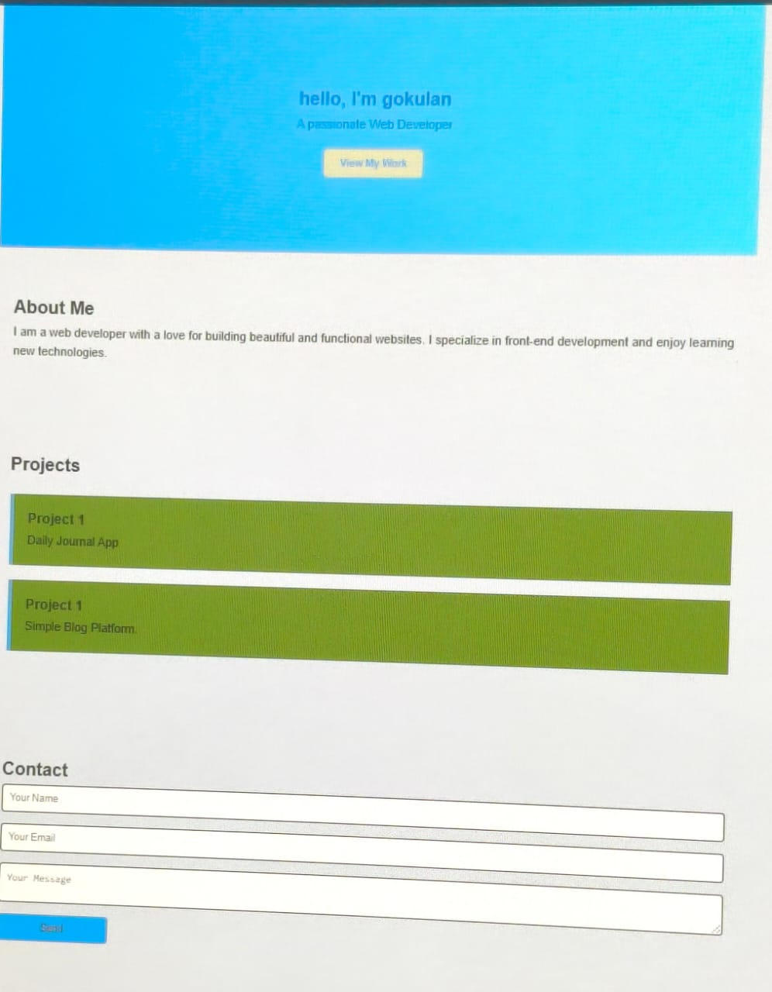

RESULTS AND SCREENSHOTS
3/21/2024 Annual Review
10

Slide 11
CONCLUSION
Portfolio Design/Layout → one-page sections (Nav, Hero, About, Projects, Contact, Footer).
Features & Functionality → simple, responsive, smooth scrolling, projects showcase, contact form.
Conclusion → keeps it clean, minimal, and user-friendly.
11

Slide 12
GITHUB LINK
https://github.com/gokulan20324u48009-cloud/digital-portfolio.git

